Slide 1

The Dating Adventure
Will you get lucky tonight?
It all depends of the decisions you make in this interactive game. Can you do it?

Slide 2
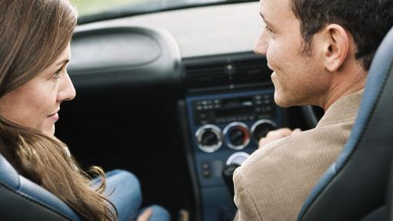
Tonight is the night, you can feel it. You stop at her driveway right when she is leaving the house. She looks stunning, in a short, black dress.
She enters the car, smiles and says “Hey, you! Where are we going tonight?”.

Slide 3

The waiter sits you and her in a quiet table, at the corner of the room.
The food is delicious, and the conversation is going pretty well. After a while, she stops talking, looks you deeply in the eye, and smiles…

Slide 4
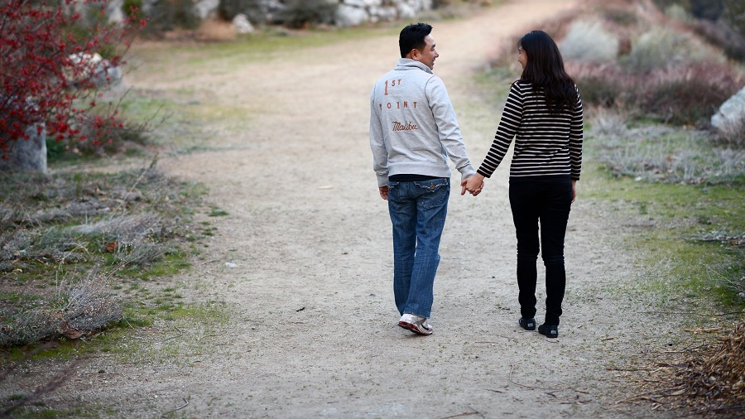
After dinner you take her for a walk in the nearby park. Things are looking good so far!
She looks at you and asks… “so, what are we doing now?”

Slide 5
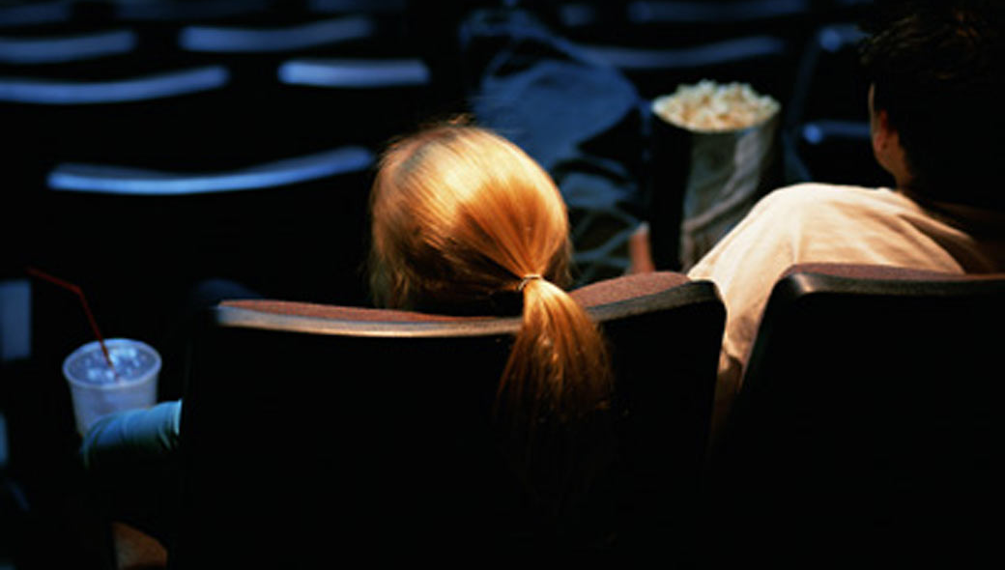
The theater is almost empty, so you choose a center seat with her.
About halfway into the movie, she whispers in your ear: “This movie is kinda boring, don’t you think?”.
You look at her and she giggles…

Slide 6
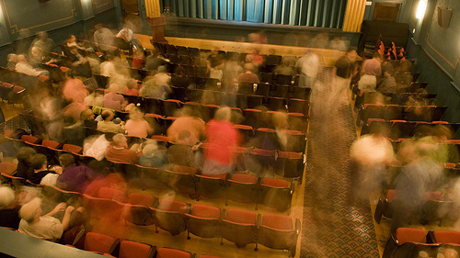
After the movie is over, she looks at you and says:
“I still feel like doing something else… any suggestions?”

Slide 7
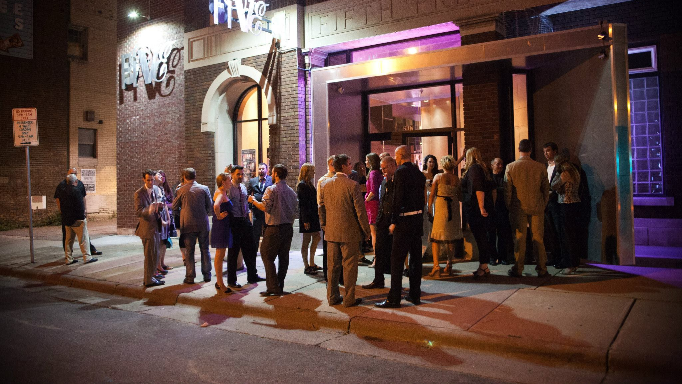
This sounds exciting! There’s a crowd outside and you can hear the music pumping. Your date can barely wait to get in…
As you join the entrance line, you take your time to decide what you should do first once you get inside…

Slide 8
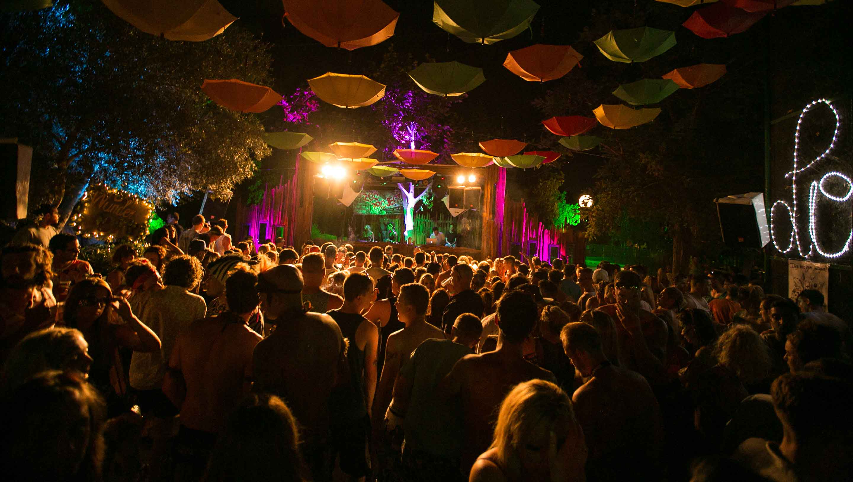
The dance floor is lit!
The DJ is dropping hit after hit, everybody is dancing and jumping and you can feel the excitement in the air.
As the crowd moves you are pushed closer to your date; she doesn’t stop dancing and looks at you… what do you do?

Slide 9
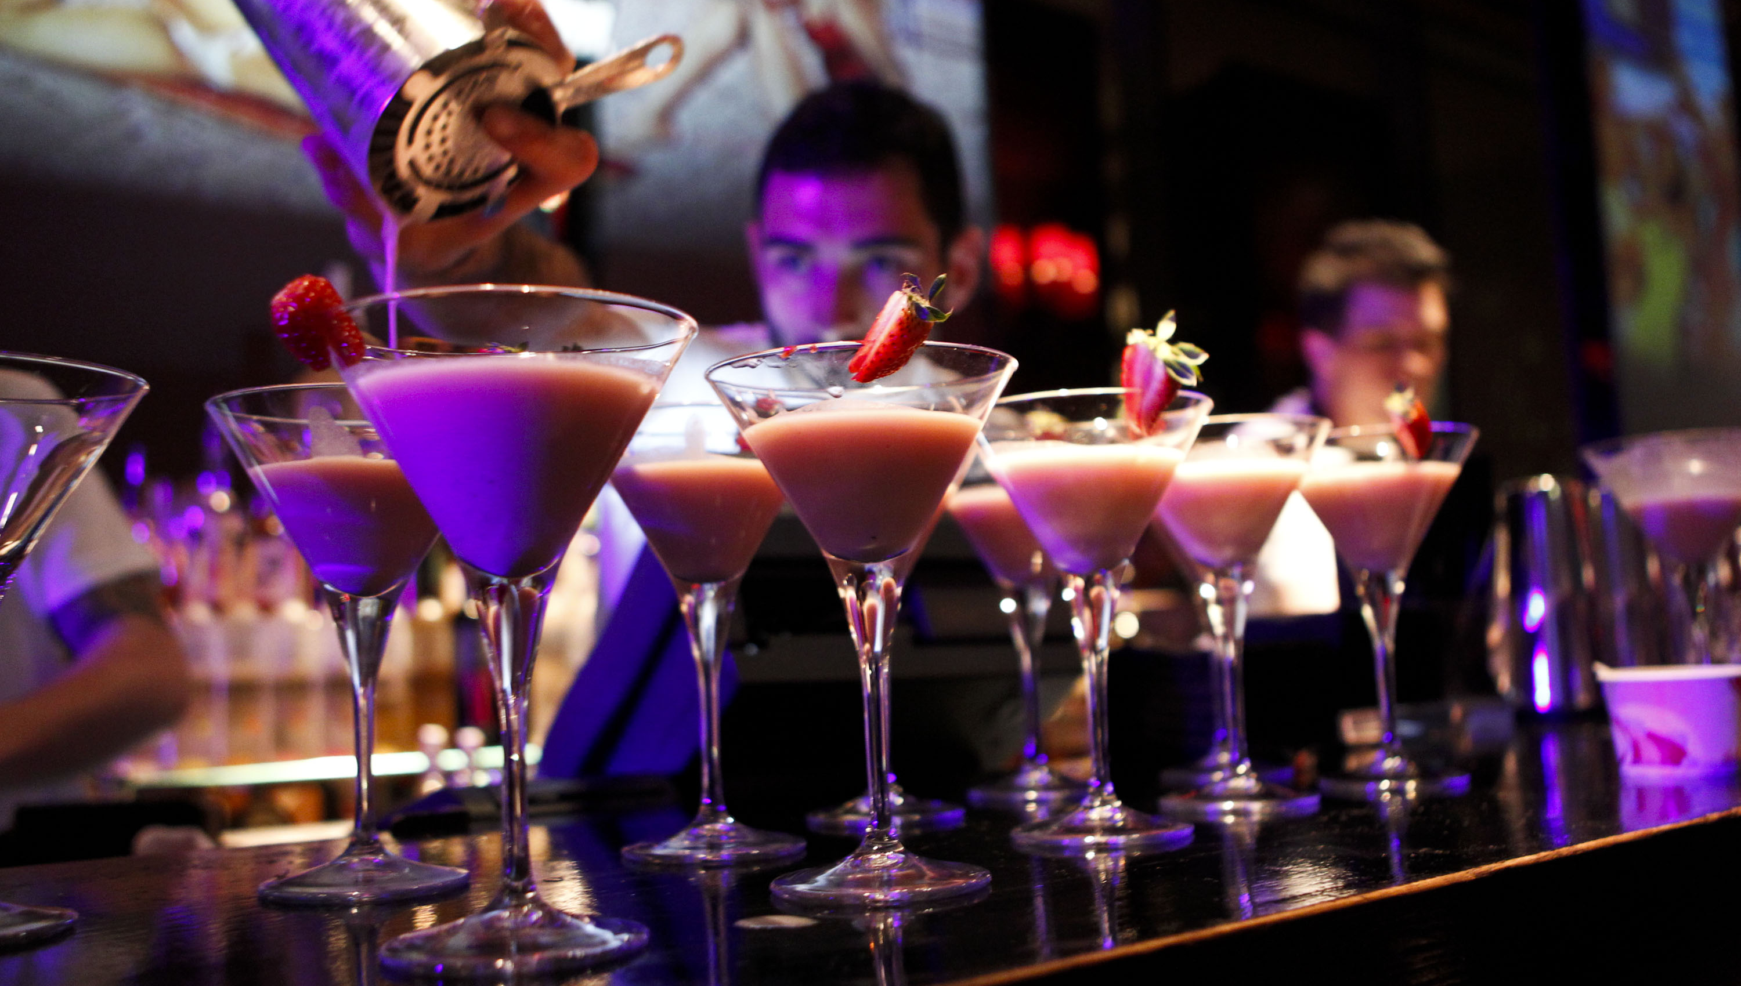
You just hit the jackpot: today, women drink for free until midnight!
Your date seems hypnotized by the bartenders juggling bottles in the air. But she breaks off of her spell and asks you: “So, are we drinking or not?”

Slide 10
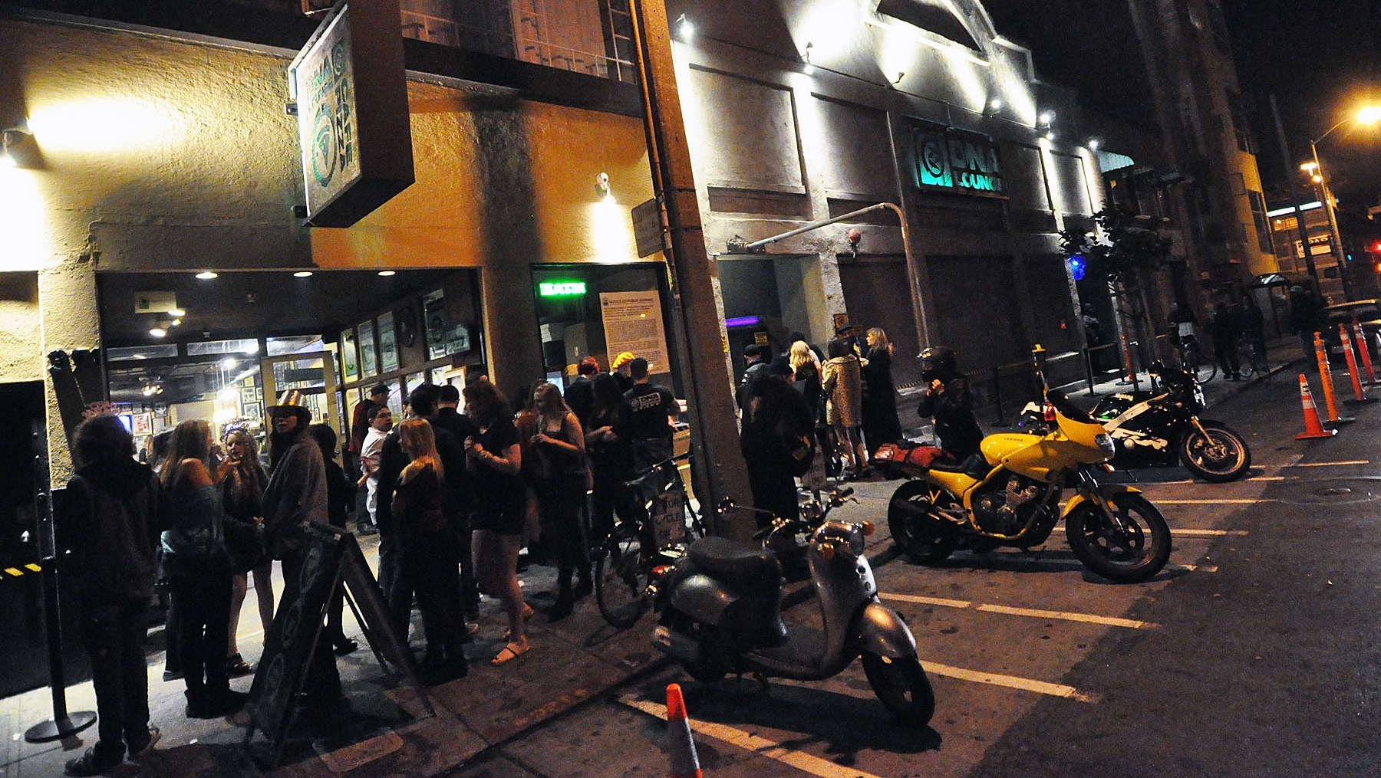
The line to enter the club is even bigger than it was when you arrived…
As you leave, she says: “I had a great time! Where should we take this party now?”

Slide 11

After you enter her apartment, you sit on the couch for a while and then… she asks if she can kiss you!
Things are getting hot in here! What do you do next?

Slide 12

Oh no… everything was going so good so far!
This is so frustrating… any last resorts you want to try?

Slide 13
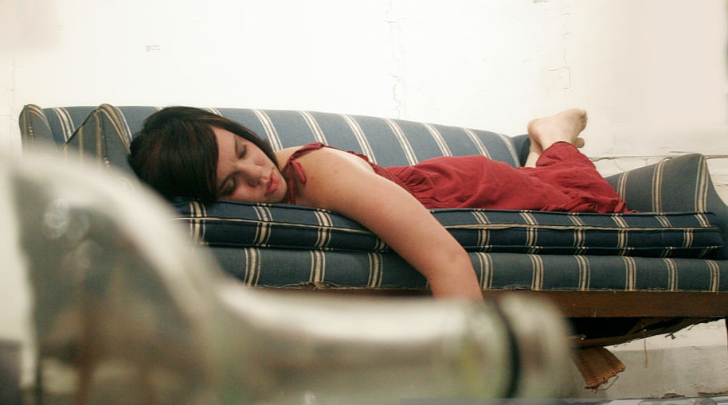
Well, she definitely had one too many!
As you take her back to her apartment, she can barely walk. After entering the place, she falls down on the couch, laughing and saying slurred words. And she is pointing at you!
Hmm, maybe she wants something else?...

Slide 14

Awesome sauce!
Boy, did we get lucky tonight!
And the best part? You made sure you got consent from your date. This is how you build a healthy relationship: making sure the other party is comfortable and doing only what she wants to do.
But remember: silence isn’t consent. And the other person cannot consent if he/she is drunk or high. So, get that yes before you smash!

Slide 15
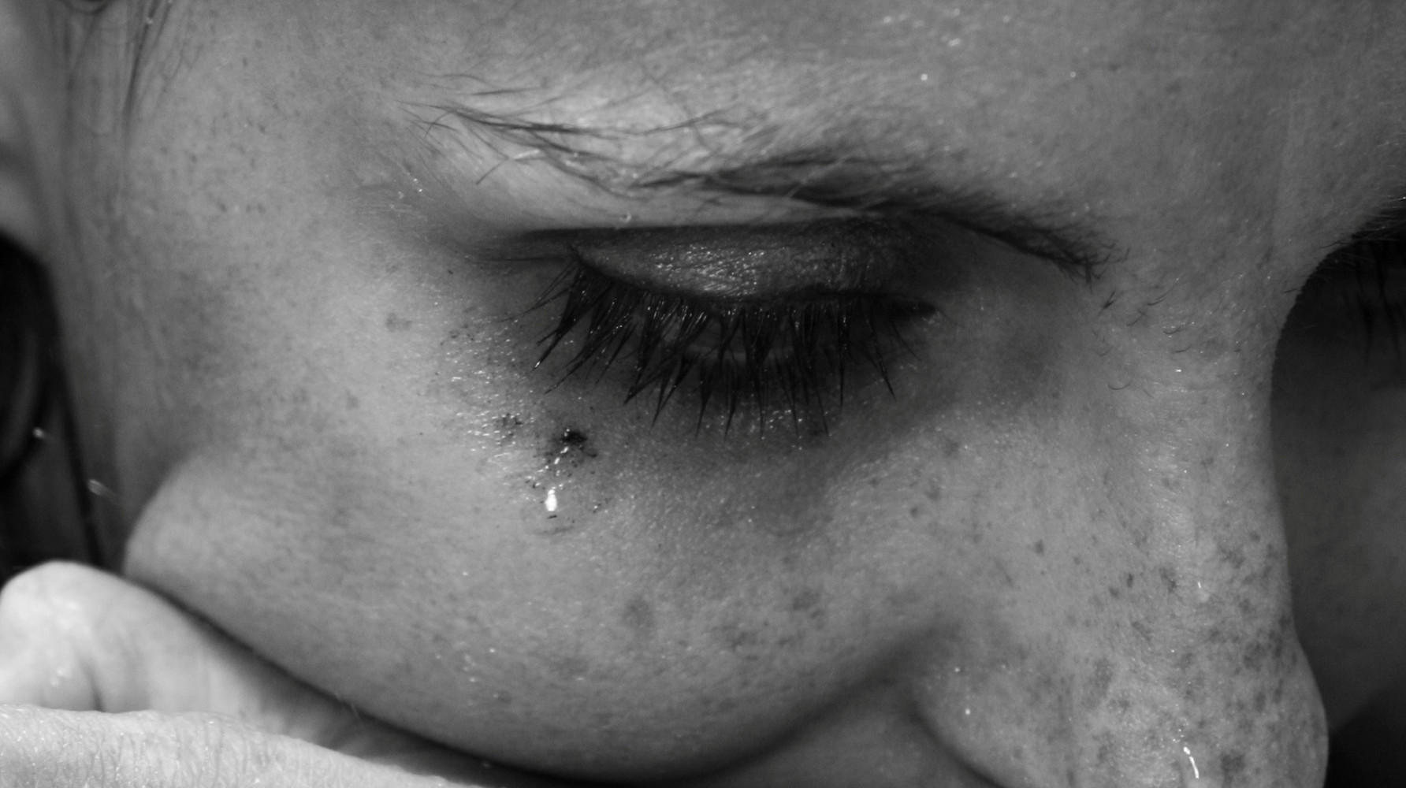
This was so not cool.
A relationship without consent is a bad relationship. You can’t assume or imply the other person wants to do something: it is fundamental to ask first.
Also, you cannot force someone into saying yes by using coercion, threats, intimidation – physical or verbal – or emotional abuse, like name-calling or humiliation. This is serious business: in Canada, and many other countries, you can be charged with sexual assault or even rape.

Slide 16
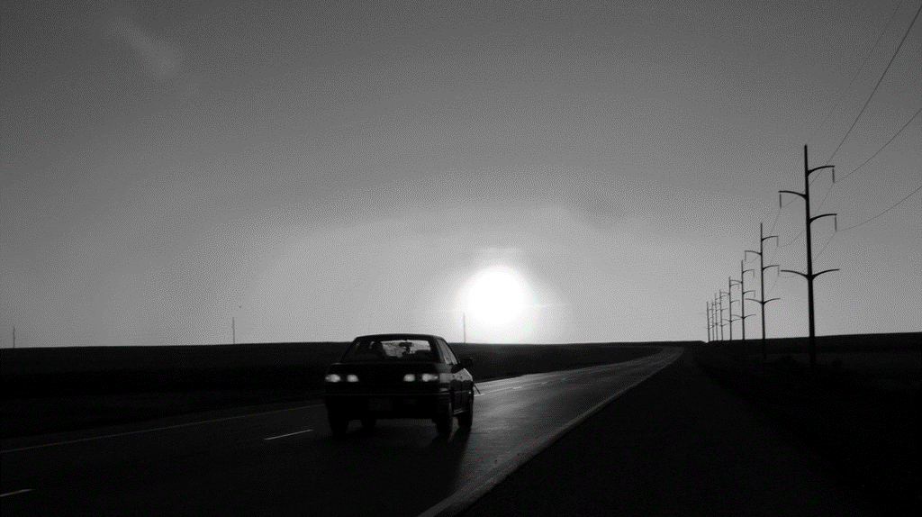
Bummer…
Well, it didn’t work this time.
As you drive home, you think… what could I have done differently? What does she need to go to bed with me? What made her feel uncomfortable?
Many questions… maybe we should start asking them, don’t you think?

Slide 17

Silence is not consent!
This is a very serious issue. If you don’t know for sure what the other person want, you cannot make any assumptions.
Also, the other person cannot consent if he/she is drunk or high.
Even if you think he/she was into it, you might be charged with sexual assault or rape. So, remember: only yes means yes.

